Slide 1
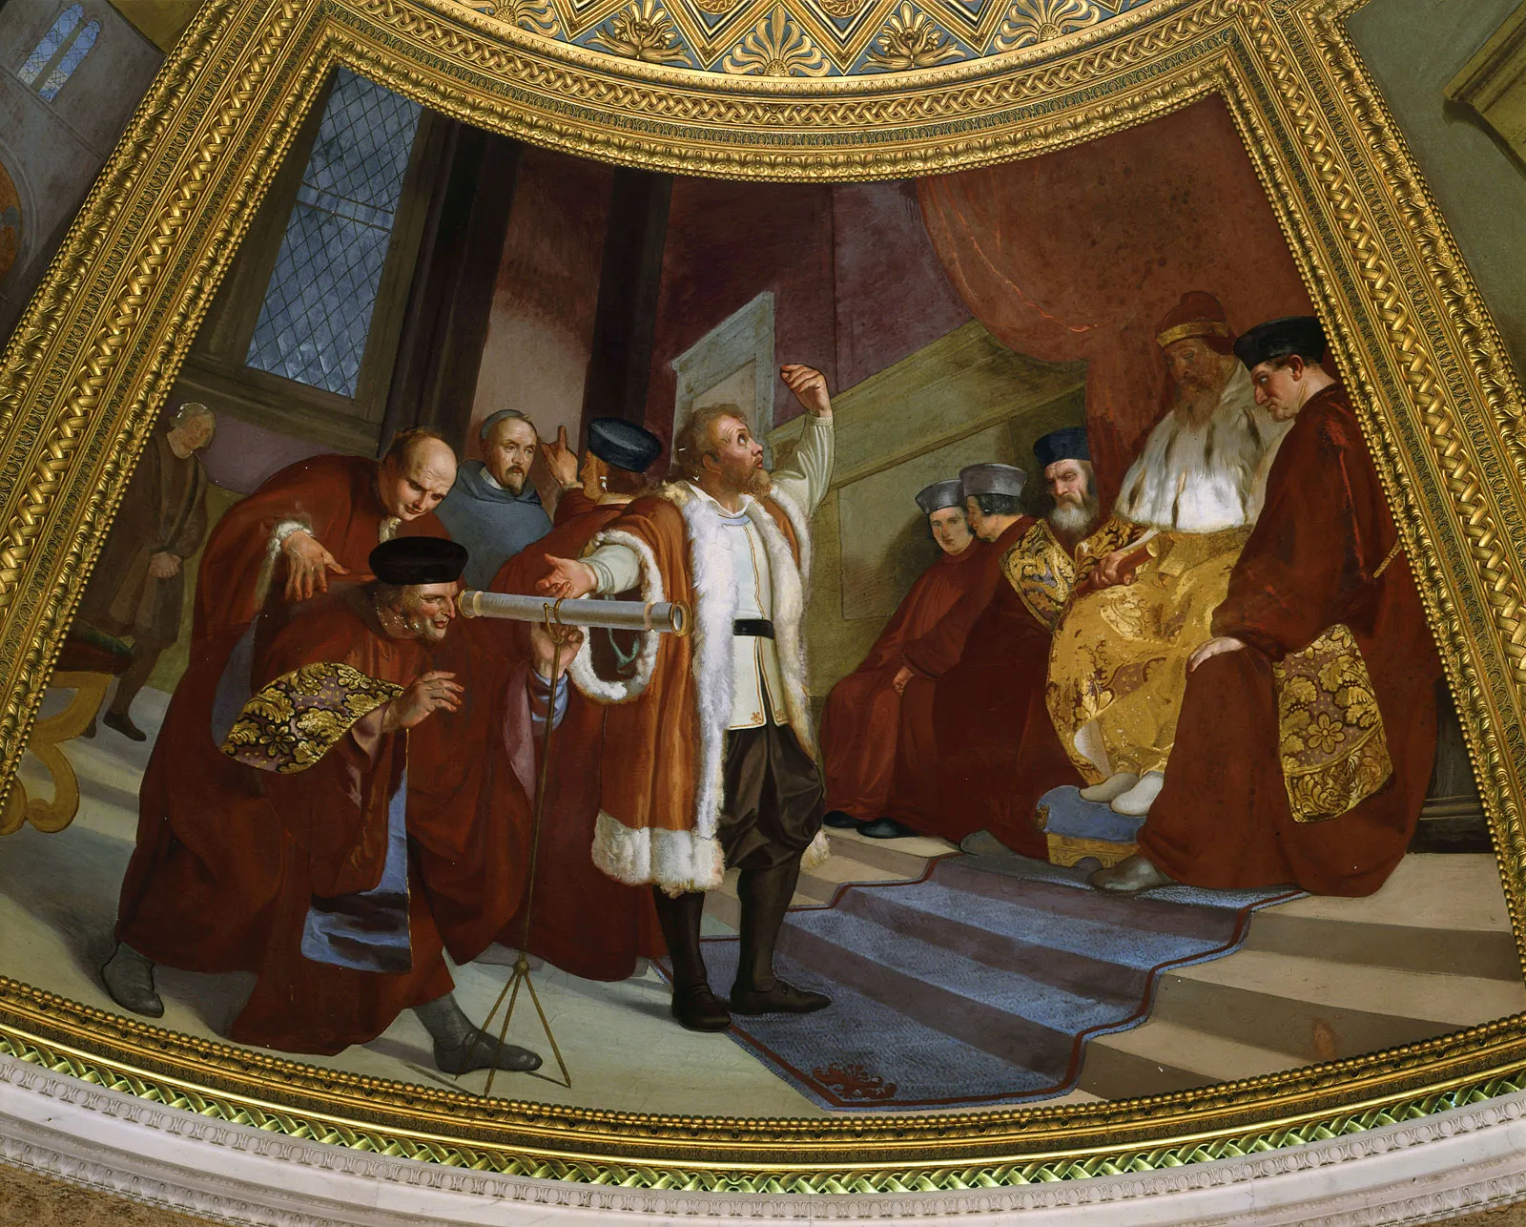
Replication/Revision/Rejection
Conclusion
L(M|D) ∝ P(D|M) Frequentist
P(M|D) ∝ P(D|M) · P(M) Bayesian
Causal claim
Causal effects Explanations
Causal inference
Galileo Galilei (1564-1642) the “father of modern science”
Data
Model
Inference algorithm
Statistical inference Machine learning
Observations
Predictions
P(D|M)
Natural process
Causal model
DGP model
Probability theory
Inductive reasoning
Real world
Abstract world
Propositional logic Deductive reasoning
Empiricism
Rationalism
Notes:
A probability model is the triplet (Ω, σ-algebra, P)
Generative vs Discriminative

Slide 2
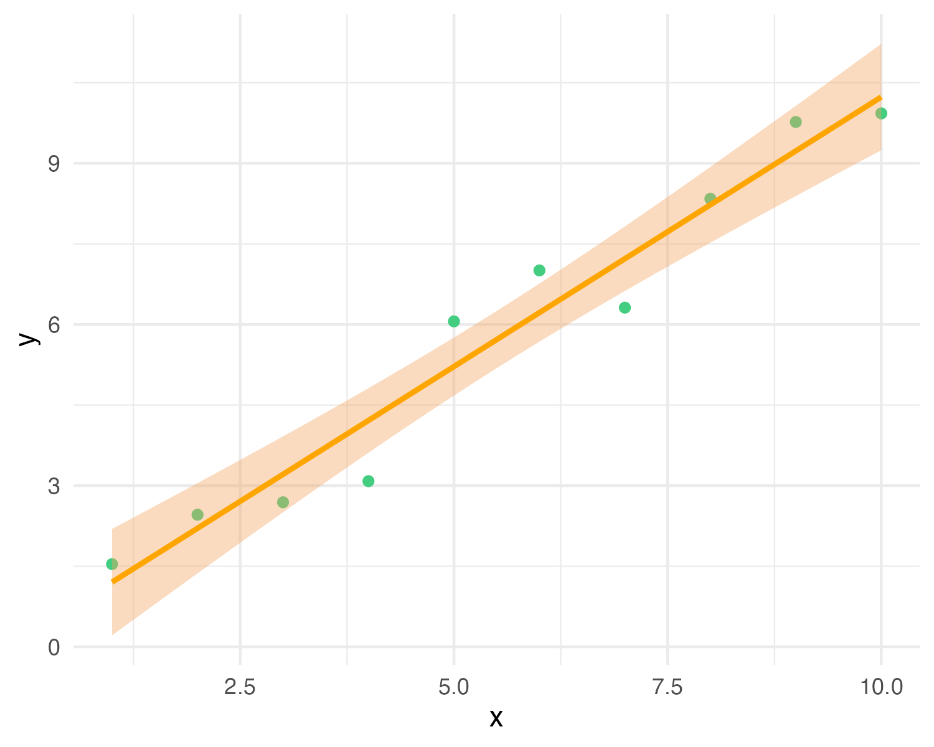
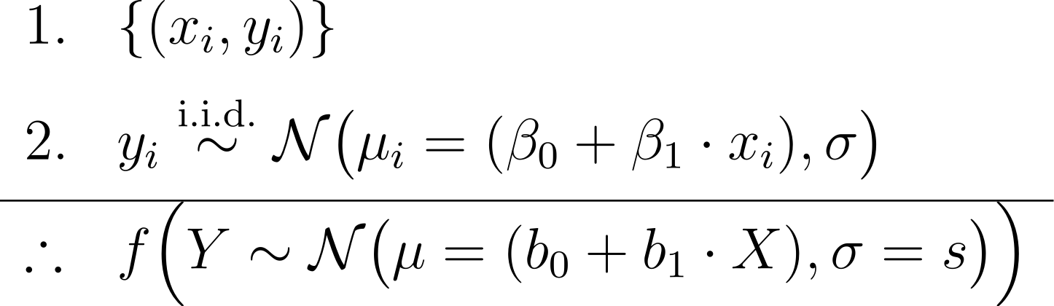
y_{i} ∼ N(μ_{i} = (β₀ + β₁ · x_{i}), σ)
premises assumptions evidence KB
premises
data
causal model
conclusion
likelihood (+ prior)
estimator
Y = b₀ + b₁X with CI
MLE (or posterior) predictive model
effect
= conclusion claim hypothesis query
Notes:
In Bayesian inference we add priors to the premises, and obtain a joint posterior distribution of the parameters conditioned on the data p(beta0, beta1, sigma | data), or a posterior predictive distribution as conclusion
In frequentist inference we obtain maximum-likelihood estimates of the parameters (b0, b1, s)
https://latex.unacademy.com/
\begin{array}{ll}
1. & \{(x_i, y_i)\} \\[6pt]
2. & y_i \stackrel{\text{i.i.d.}}{\sim} \mathcal{N}\bigl(\mu_i = (\beta_0 + \beta_1 \cdot x_i), \sigma\bigr) \\[4pt]
\hline
\therefore & f \Bigl(Y \sim \mathcal{N}\bigl(\mu = (b_0 + b_1 \cdot X), \sigma = s\bigr)\Bigr) \\
\end{array}

Slide 3
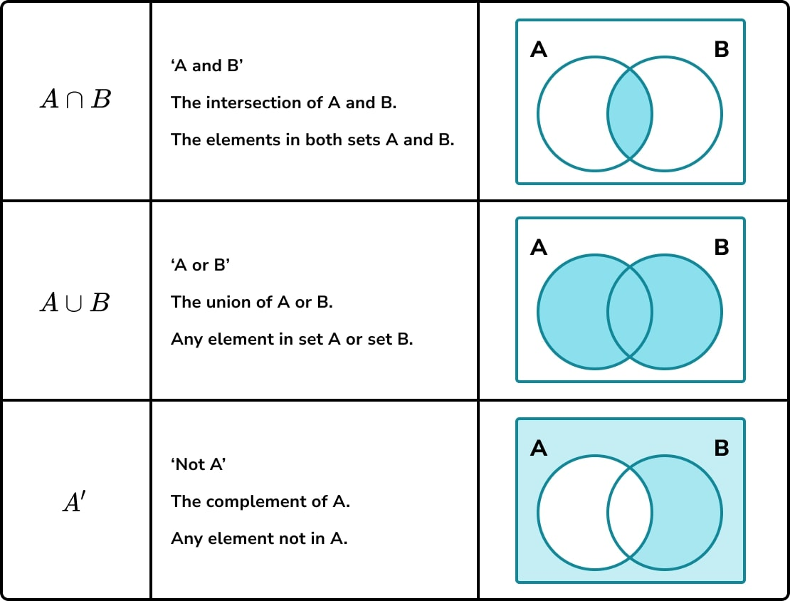

Slide 4
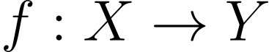
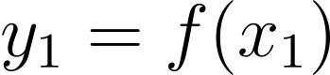
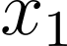
Range
X
Domain
Y
Codomain

Slide 5
S P(S) = 1
A P(A) = 0.1
B P(B) = 0.1
A ∩ B P(A ∩ B) = 0.03

Slide 6
B P(B) = 0.1
A ∩ B P(A ∩ B) = 0.03

Slide 7
B P(B)/P(B) = 0.1/0.1 = 1
A ∩ B P(A ∩ B)/P(B) = P(A | B) = 0.03/0.01 = 0.3

Slide 8
S P(S) = 1
A P(A) = 0.3

Slide 9
S P(S) = 1
A P(A) = 0.1
B P(B) = 0.1
A ∩ B P(A ∩ B) = 0.03

Slide 10
S P(S) = 1
A P(A) = 0.1
B P(B) = 0.1
A ∩ B P(A ∩ B) = 0.01

Slide 11
S P(S) = 1
A P(A) = 0.1
B P(B) = 0.1
A ∩ B P(A ∩ B) = 0

Slide 12
S P(S) = 1
A = B P(A) = P(B) = 0.1
A ∩ B P(A ∩ B) = 0.1

Slide 13
S
A

Slide 14
B₁
B₂
B₃
B₄
A
A ∩ B₁ = ∅
A ∩ B₂
A ∩ B₃
A ∩ B₄ = ∅

Slide 15
S P(S) = 1
A P(A) = 0.1
B P(B) = 0.1
A ∩ B P(A ∩ B) = 0.03

Slide 16
S P(S) = 1
A P(A) = 0.1

Slide 17
S P(S) = 1
A P(A) = 0.1

Slide 18
S P(S) = 1
A P(A) = 0.1
B P(B) = 0.1
A ∩ B P(A ∩ B) = 0.03

Slide 19
S P(S) = 1
A P(A) = 0.1
B P(B) = 0.1
B P(B) = 0.1
A ∩ B P(A ∩ B) = 0.03

Slide 20
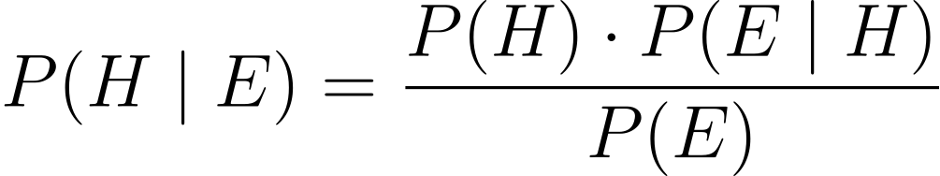
PRIOR
LIKELIHOOD
POSTERIOR
EVIDENCE

Slide 21
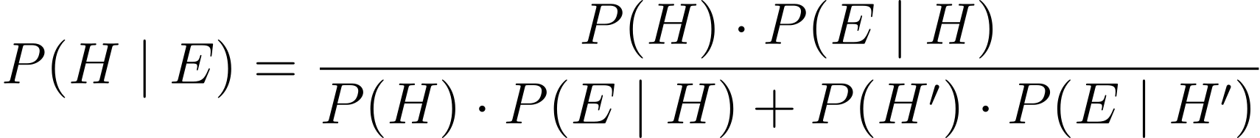
PRIOR
LIKELIHOOD
POSTERIOR
EVIDENCE

Slide 22
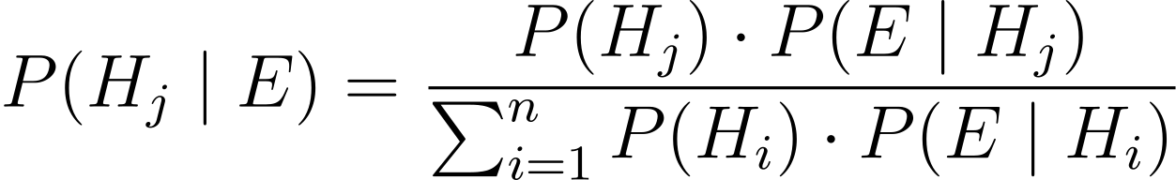
PRIOR
LIKELIHOOD
POSTERIOR
EVIDENCE

Slide 23
POSTERIOR
PRIOR
LIKELIHOOD

Slide 24
PRIOR
LIKELIHOOD
POSTERIOR
EVIDENCE

Slide 25
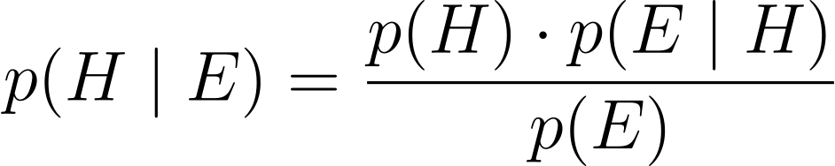
PRIOR
LIKELIHOOD
POSTERIOR
EVIDENCE

Slide 26
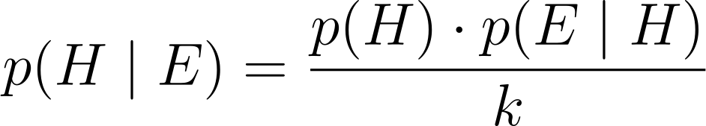
PRIOR
LIKELIHOOD
POSTERIOR
KNOWN NORMALIZING CONSTANT

Slide 27
POSTERIOR
PRIOR
LIKELIHOOD

Slide 28
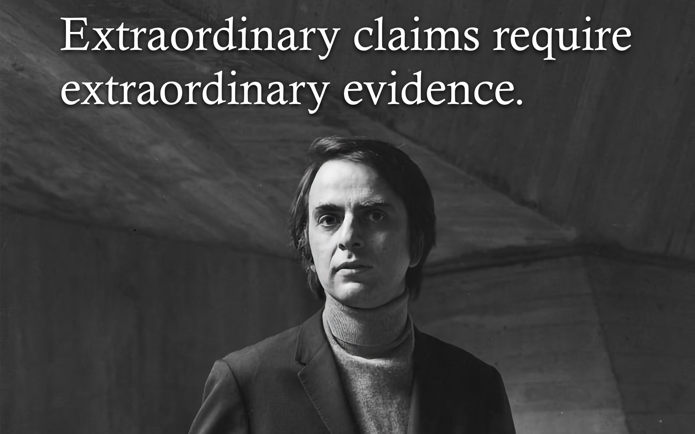
POSTERIOR
PRIOR
LIKELIHOOD

Slide 29
PRIOR
LIKELIHOOD
POSTERIOR
EVIDENCE

Slide 30
LIKELIHOOD
EVIDENCE

Slide 31
LIKELIHOOD
UNKNOWN CONSTANT

Slide 32
LIKELIHOOD
UNKNOWN CONSTANT

Slide 33
LIKELIHOOD FUNCTION
LIKELIHOOD
UNKNOWN CONSTANT

Slide 34
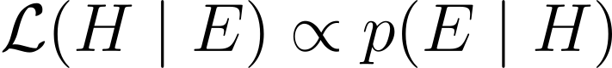
LIKELIHOOD FUNCTION
LIKELIHOOD

Slide 35
Modeling
Premises
Causes
Reasoning
Learning
Conclusion
Effect

Slide 36
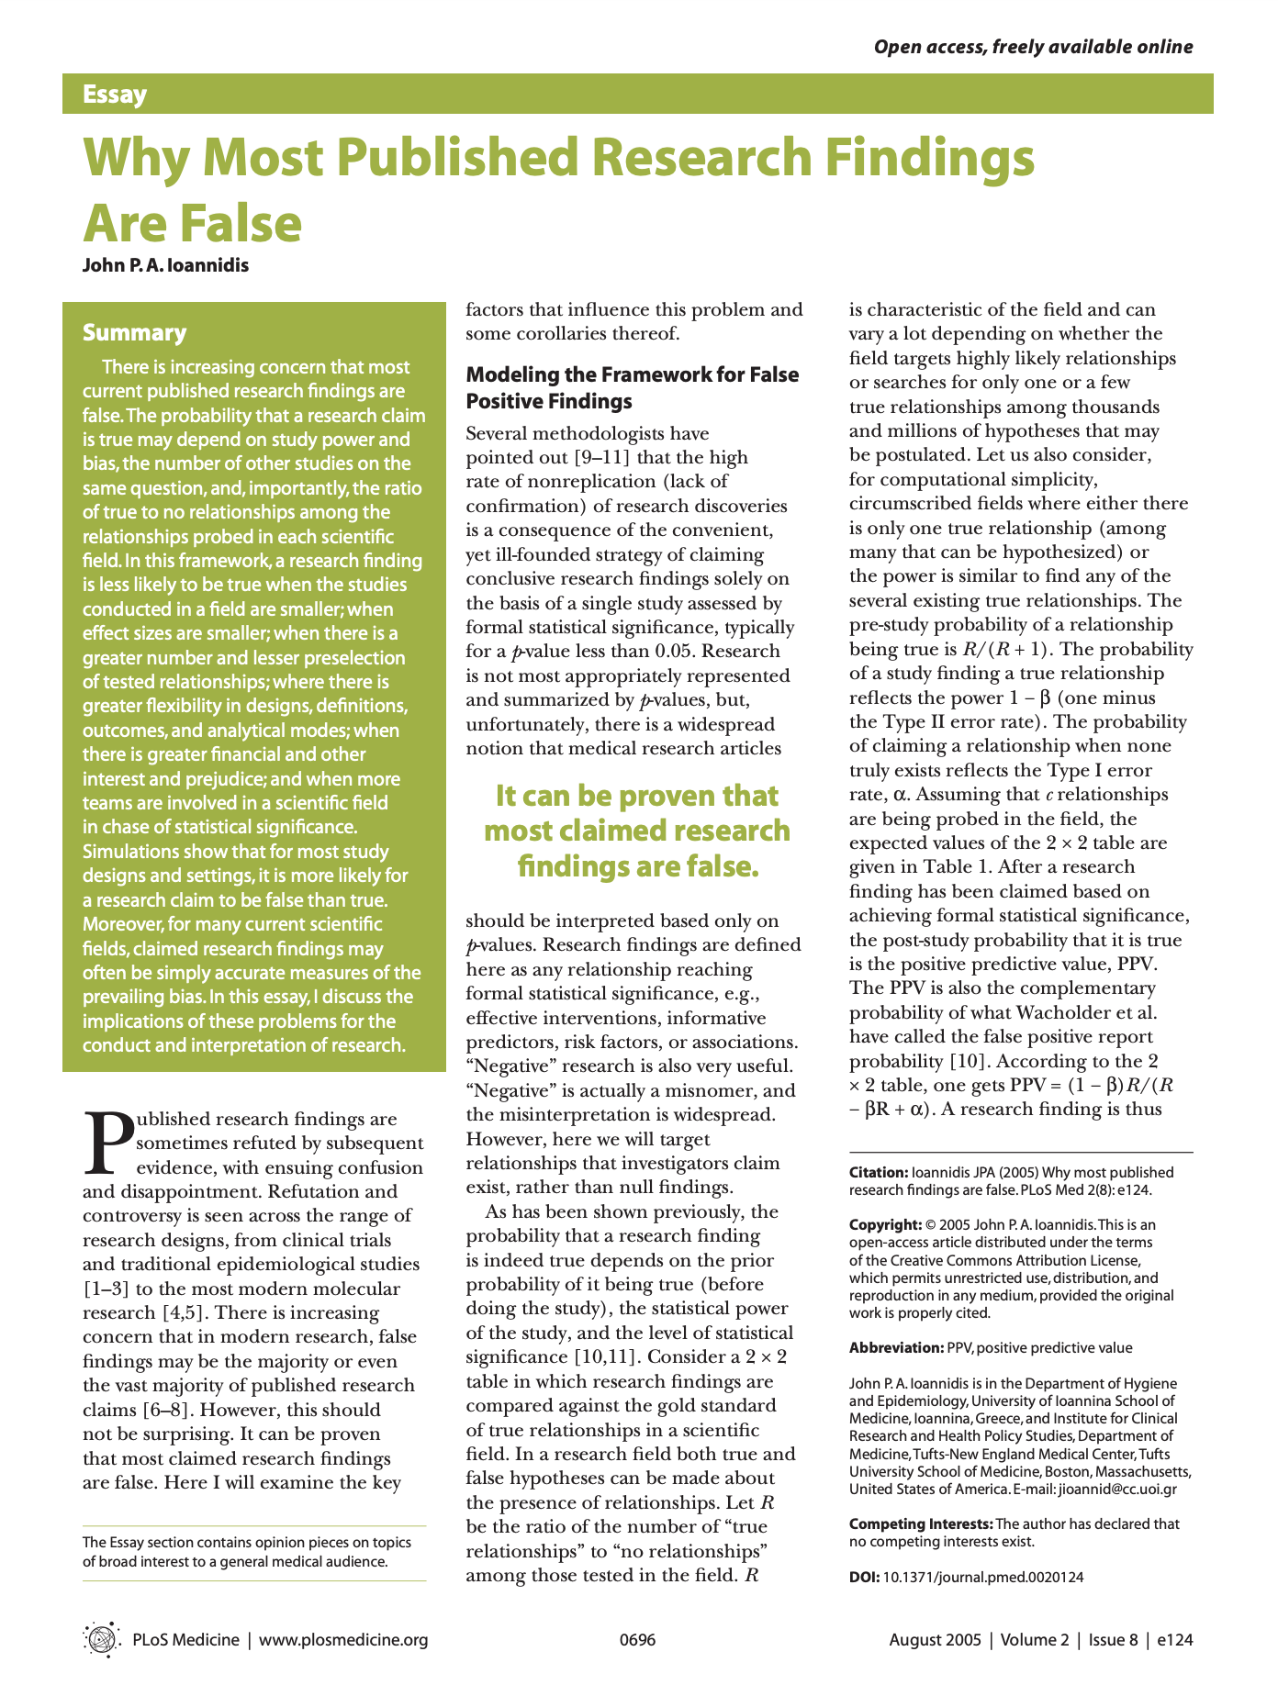
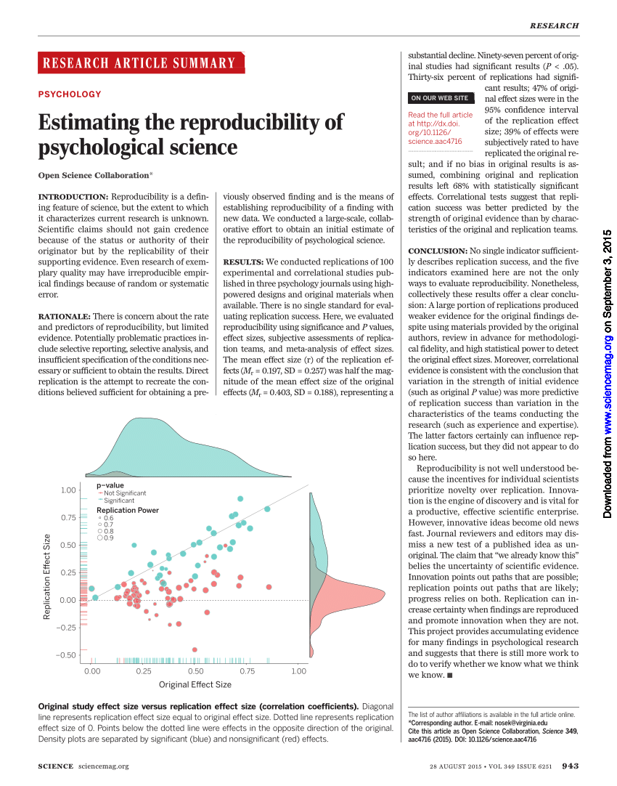

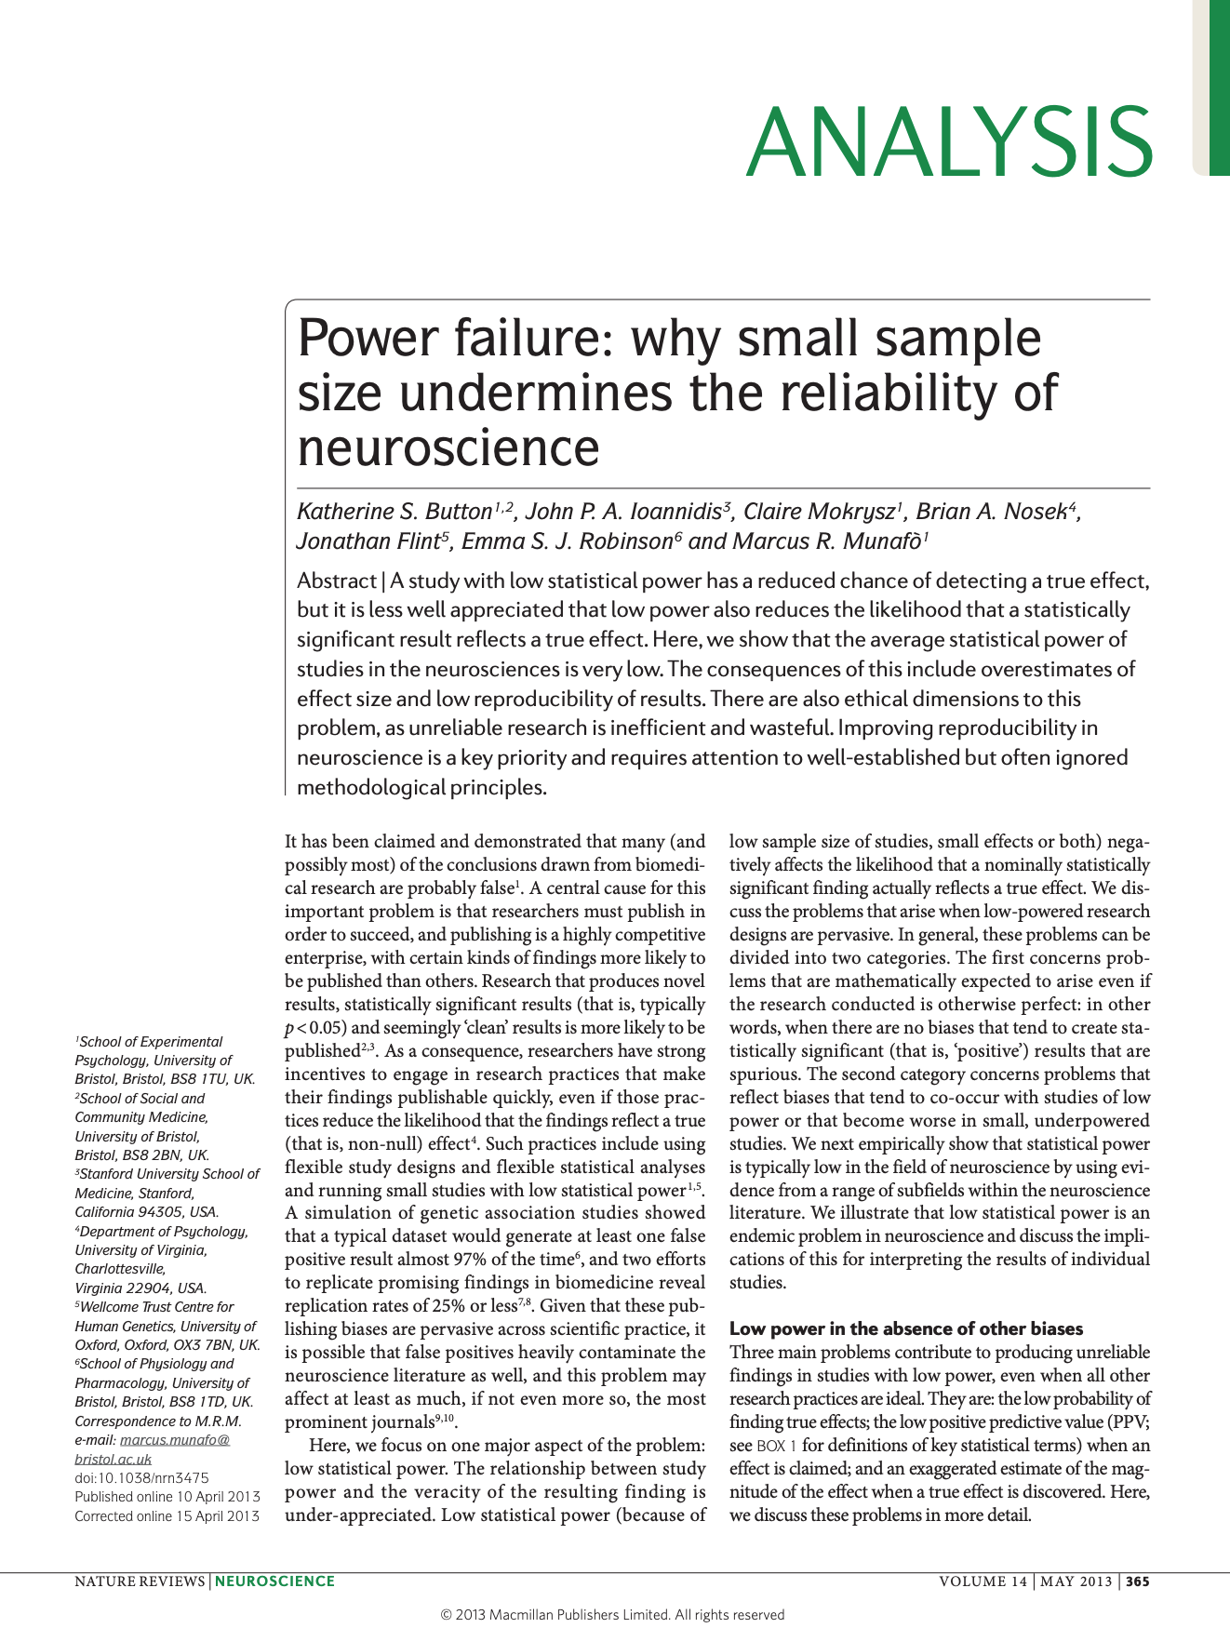

Slide 37
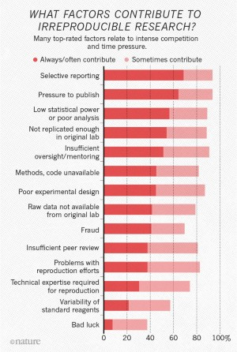
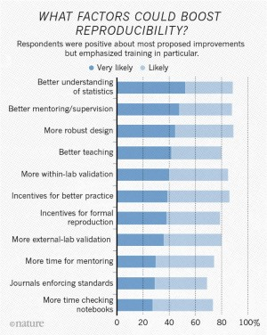
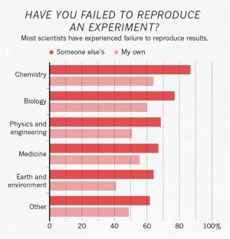

Slide 38
Y = β₀ + β₁X + ε
premises
conclusion
Y = b₀ + b₁X with CI

Slide 40
P₁
P₂
⋮
P_{n}
⎯
C

Slide 41
P₁
P₂
⋮
P_{n}
⎯
C
E
⎯
H
E = P₁ ∧ P₂ ∧ … ∧ P_{n}

Slide 42
P₁
P₂
⋮
P_{n}
⎯
C
E
⎯
H
E = P₁ ∧ P₂ ∧ … ∧ P_{n}
E ⇒ H

Slide 43
P₁
P₂
⋮
P_{n}
⎯
C
Deductive reasoning
E
⎯
H
E ⊨ H
E ⊭ H
E = P₁ ∧ P₂ ∧ … ∧ P_{n}
E ⇒ H

Slide 44
P₁
P₂
⋮
P_{n}
⎯
C
Deductive reasoning
E
⎯
H
V(H | E)
E = P₁ ∧ P₂ ∧ … ∧ P_{n}
E ⇒ H

Slide 45
P₁
P₂
⋮
P_{n}
⎯
C
Deductive reasoning
Inductive reasoning
E
⎯
H
V(H | E)
P(H | E)
E = P₁ ∧ P₂ ∧ … ∧ P_{n}
E ⇒ H

Slide 46

Notes:
A probability model is the triplet (Ω, σ-algebra, P)
Generative vs Discriminative

Slide 47
Replication/Revision/Rejection
Conclusion
L(M|D) ∝ P(D|M) Frequentist
P(M|D) ∝ P(D|M) · P(M) Bayesian
Causal claim
Causal effects Explanations
Causal inference
Data
Model
Inference algorithm
Statistical inference Machine learning
Observations
Predictions
P(D|M)
Natural process
Causal model
DGP model
Probability theory
Inductive reasoning
Real world
Abstract world
Propositional logic Deductive reasoning
Empiricism
Rationalism
Notes:
A probability model is the triplet (Ω, σ-algebra, P)
Generative vs Discriminative

